Slide 1
What makes a good movie?
An Exploratory Data Analysis
by Michael Loos

Slide 2
Data Set and Variables
The data set contains 81,273 movies from IMDB
https://www.kaggle.com/stefanoleone992/imdb-extensive-dataset
Variables include:
Title
Year
Genre
Duration
Country
Language
Average Vote (Rating)
Votes
Budget
US Gross Income
Metascore (Critics’ rating)
The analysis will focus on Year, Duration, Average Vote, Votes, Budget, US Gross Income, and Meta Score

Slide 3
Variables Used in Analysis
Year-Year movie was released
Duration-Length of movie in minutes
Average Vote-Average user vote on scale of 1 to 10
Votes-Number of votes
Budget-Budget for movie
US Gross Income-Box office income in Dollars. Later calculated to be in Millions
Metascore-Critics score on scale of 1 to 100

Slide 4
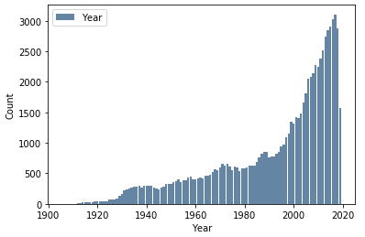
Year
Mean: 1993
Mode: 2017
Variance: 575.63
Standard Deviation: 23.99
Distribution is skewed but no real outliers

Slide 5
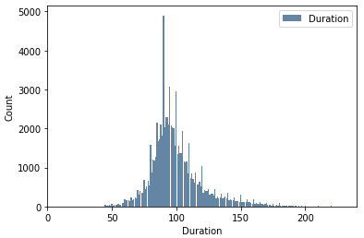
Duration
Mean: 100.57
Mode: 90
Variance: 641.11
Standard Deviation: 25.32
1 large outlier at 3360, with some other outliers beyond ~175 minutes

Slide 6
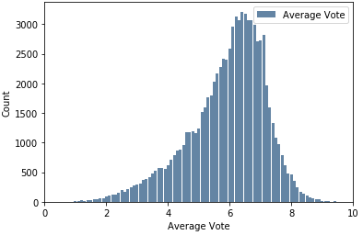
Average Vote
Mean: 5.93
Mode: 6.4
Variance: 1.55
Standard Deviation: 1.24
Distribution is skewed but no outliers

Slide 7
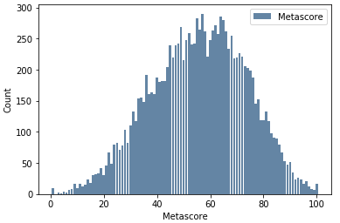
Metascore
Mean: 55.76
Mode: 57
Variance: 315.33
Standard Deviation: 17.76
Pretty continuously distributed so no outliers

Slide 8
Budget
While I wanted to use this variable in the analysis, there is an issue of inconsistent currencies. This would be very difficult to correctly adjust to US Dollars when considering conversion rates at the time. This significantly changes the summary statistics.
Mean:95951670
Mode: 1000000
Variance: 7.452 e¹⁸
Standard Deviation: 2729936553.57

Slide 9
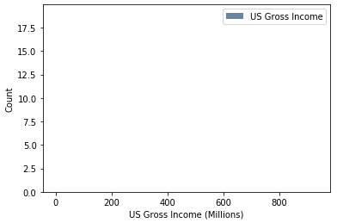
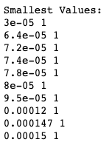
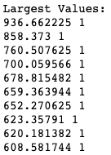
US Gross Income (millions)
Mean: 19.62
Mode:1
Variance:2312.56
Standard Deviation:48.09
Outliers on each end of distribution
Histogram is poor visual due to continuous nature of variable

Slide 10
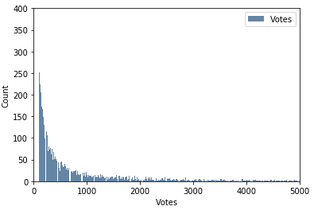
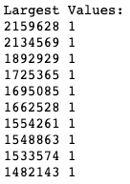
Votes
Mean: 9421.77
Mode: 103
Variance: 2,725,095,483.52
Standard Deviation: 52,202.45
Many outliers in upper end of distribution

Slide 11
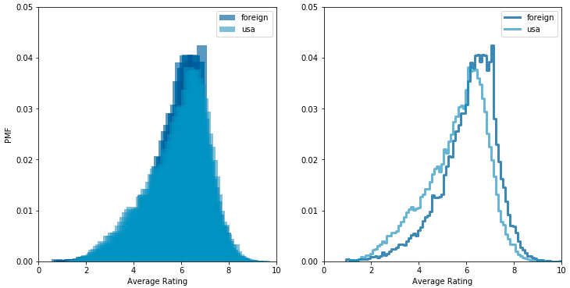
PMF
The data set contains US and foreign films
The PMF of average rating for foreign films is shifted towards higher votes than US films

Slide 12
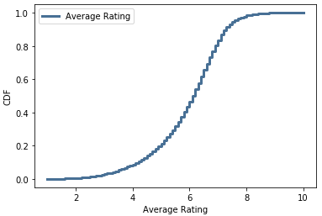
CDF
The CDF of the average rating helps show what portion of the movies fall below a specific rating
53% of movies have an average rating higher than 6
The median rating is 6.1

Slide 13
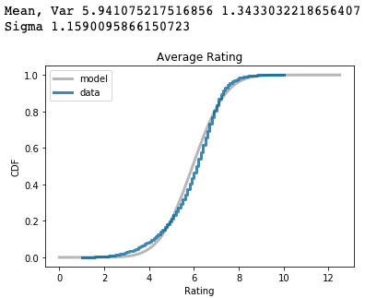
CDF
The estimated parameters slightly differ from calculated parameters earlier
CDF is distributed differently than model

Slide 14
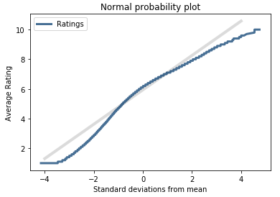
Analytical Distribution
The normal probability plot of average votes shows the distribution deviates from a normal distribution

Slide 15
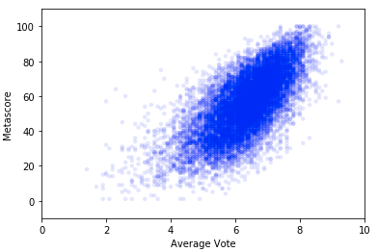
Scatter Plots
The scatter plot shows a strong, positive correlation between average vote and metascore
Voters and critics largely agree on ratings
This is confirmed by the correlation value: .69

Slide 16
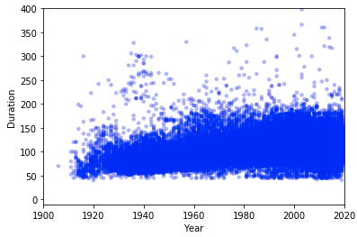
Scatter Plots
The scatter plot shows a weak, positive correlation between year and duration
This is confirmed by the correlation value: 0.15

Slide 17
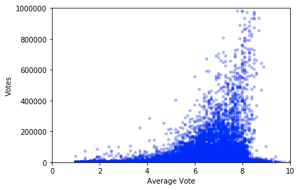
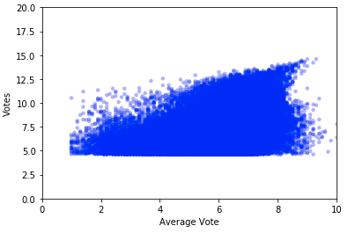
Scatter Plots
The scatter plot shows a positive correlation between average vote and total votes
This is confirmed by the correlation value: .164
Taking the log of votes shows a different plot with a higher correlation: .29

Slide 18
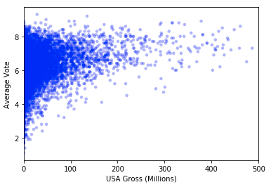
Scatter Plots
The scatter plot shows a weak, positive correlation between average vote and US Gross Income
This is confirmed by the correlation value: .16

Slide 19
Hypothesis Test
Let the null hypothesis be no correlation between average vote and metascore
We reject the null hypothesis with a p-value of 0.0

Slide 20
Hypothesis Test
Let the null hypothesis be no difference in means between the average vote of US and foreign movies
Us mean: 5.589
Foreign mean: 6.100
Difference: 0.511
We reject the null hypothesis with a p-value of 0.0

Slide 21

Linear Regression Analysis
Linear regression of average vote predicted by US Gross Income
The slope is statistically significant
With a starting average rating of 6.23, the rating increases by 0.0034 for every million dollars in US Gross Income
Intercept: 6.2281
Slope: 0.0034
R²: .026
Box office income is not a great predictor for average rating

Slide 22
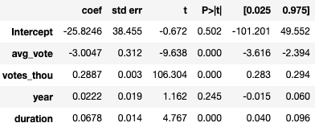
Multiple Regression Analysis
Multiple linear regression of US Gross Income (millions) predicted by average rating, votes (in thousands), year, and duration
Average rating, votes, and duration are significant predictors while year is not
With a starting US Gross Income of $-25.824 million, the income decreases by $3 million for each point increase in average rating, increases $289 per vote and $68,000 per minute
Intercept: -25.824
Average Rating: -3.004
Votes (thousands): 0.2887
Year: 0.0222
Duration: 0.068
R²: .454

Slide 23
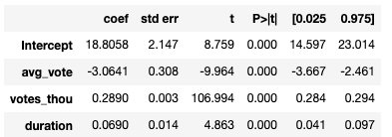
Multiple Regression Analysis
Removing year has bi impact to fit of model, but intercept change quite a bit
Average rating, votes, and duration are still significant predictors
With a starting US Gross Income of $18.806 million, the income decreases by $3.06 million for each point increase in average rating, increases $289 per vote and $69,000 per minute
Intercept: 18.806
Average Rating:-3.064
Votes (thousands): 0.289
Duration: 0.069
R²: .454

Slide 24
Conclusion
I think we can measure the success of a movie in several ways based on US Gross Income, Average Rating, and Metascore
While there is a high correlation between average rating and metascore, there is little correlation between Income and Rating
We can predict the average vote by income, votes, and duration
We can predict the Gross Income by average rating, votes, and duration
Average rating, income, votes, and durations are significant contributors

